Slide 1
R Programming Language Demo
Project Description & Demo
CSCI 6221 – Group 2
Ayush Dwivedi| Jeff Bivin | Tyler Jones

Slide 2
What is R?
Language and environment for statistical and data analysis
Extensive computational and data visualization capabilities
Free and open source under the GNU General Public License
One of the most popular languages for statisticians, data scientists, and researchers, often behind Python
Most commonly in academia
Also commercial uses in industry
Twitter | Monitor user experience
Ford | Analyse social media to support design decisions for their cars
New York Times | Infographics, data journalism
Microsoft | Released Microsoft R Open, an enhanced R distribution and Microsoft R server after acquiring Revolution Analytics in 2015
Google | Created the R style guide for the R user community inside Google
Notes:
Mainly statistics and data analysis
Attractive for 10,000+ packages available - can extend capabilities into Machine Learning and Neural Networks
However, limited by inefficient memory use - all data for analysis must be in memory. Dependency on the specific memory of your computer.
Right behind Python as the most used language for data analysis. Generally because Python is more general use, so individuals are more likely to know and use Python already for other purposes.
Applied most commonly in academia for conducting and publishing research, but is also actively used in commercial settings as well.

Slide 3
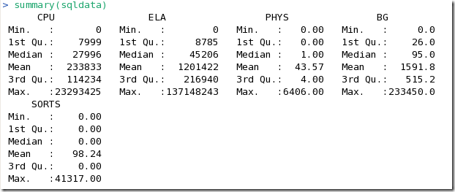
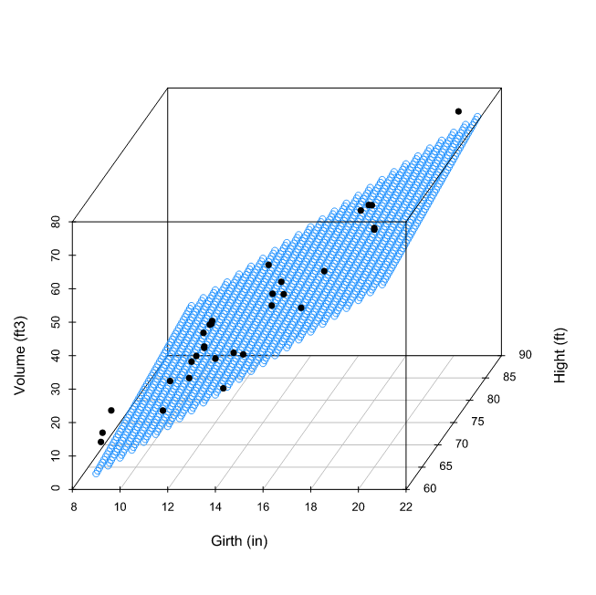
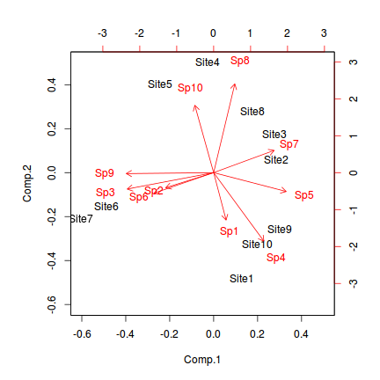
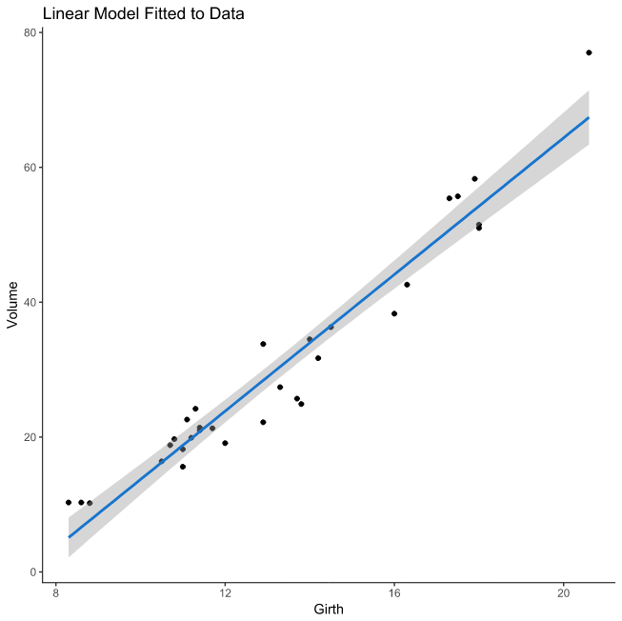
What is R?
Simple examples of using R
scatterplot3d(pred_grid$Girth, pred_grid$Height, pred_grid$Volume2
biplot(data.pca)
ggplot(data = trees, aes(x = Girth, y = Volume))
http://guyharrison.squarespace.com/blog/2011/3/3/statistical-analysis-of-oracle-performance-data-using-r.html
http://www.flutterbys.com.au/stats/tut/tut14.2.html
https://www.dataquest.io/blog/statistical-learning-for-predictive-modeling-r/
Notes:
Thousands of packages allow you to perform nearly any type of statistical or data analysis you may want. And it can produce high quality visualizations of the data
Simple “summary” command provides basic analysis of dataset
“biplot” showing principal component analysis
simple linear regression using 1 predictive variable, graphed with confidence interval (uses “ggplot”)
another linear regression using 2 predictive variables (uses “scatterplot3d”)

Slide 4
What is R?
Interpreted
Can write statements and directly execute
Object Oriented - everything is an R object, can be acted on
Vectors
Lists
Matrices
Data Frames
*Variables are not declared with a data type - get the data type of the object assigned to it
Notes:
R is an interpreted language, meaning it’s directly executed.
It’s object oriented - everything is considered an object that can be acted on.
The more common data structures used in R, in the context of statistical analysis would be…
Vectors: array of single type of element
most basic data type - every element is vector of length 1
Lists: contain elements of different types
Matrices: 2-dimensional set of elements of same type
Data frame: several vectors of equal length - what we typically think of as a dataset.
each column contains values of a single variable
each row contains one set of values from each column
doesn’t care about the types of elements it holds

Slide 5
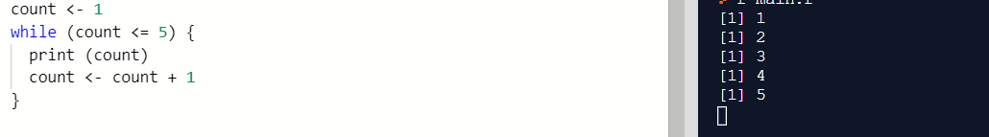
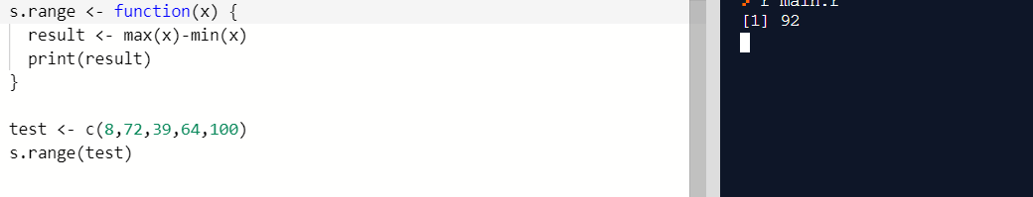
What is R?
Uses a mix of procedural, functional, imperative methods
Looping in R
Using base functions
Defining new functions
Notes:
R uses a mix of paradigms.
shows a simple example of looping in R. It supports “for” “while” and “repeat” loops - “repeat” iterates through until IF condition is met that contains “break”
Here we use the Range function to return the low and high values from a vector
Or we could define our own Range function, to instead get the spread - define “function” with its arguments, then call it with a variable

Slide 6
Experience with R
Previously, we considered the following evaluation criteria for R
Readability - ease of comprehension
Writability - ease of using the language to create programs in the appropriate domain
Reliability - extent of similar performance under different conditions
Portability - can be used in other environments and implementations
Learnability - ease of learning the language for the respective domain

Slide 7
Project Objective
This project aims to construct a model to predict innovation measured via patent grants in the short-term, local area after an Uncertainty Shock (natural disasters, terrorist attacks, sudden changes in violent crime, etc.)
This is part of broader research that aims to understand the impacts of Uncertainty Shocks on risk tolerance.
Here we model the impact to entrepreneurship and innovation on counties affected by Hurricane Katrina (August 2005).
Notes:
Aim to build a predictive model for entrepreneurship and innovation outcomes after an adverse event (Uncertainty Shock)
This is just part of broader research whose underlying hypothesis is that Uncertainty Shocks impact an individual’s risk tolerance. Therefore, they may be more likely to engage in entrepreneurial or innovative activities after an adverse events, than they otherwise would have been, had that event not occurred.
That’s a much deeper, more complex, and involved research effort than we could do here. But for the purposes of demonstrating the R language, we’ve replicating that first create a preditive model for entpreneurship and innovation. And because of the data that was available, we looked at Hurricane Katrina as our Uncertainty Shock

Slide 8
Project Methodology
Collect independent variables predictive of entrepreneurship and innovation (E&I) outcomes as dependent variables by county from years before and after Hurricane Katrina (2005)
Econometric measures of education, income, public assistance, employment, urban/rural continuum
Build an R program to analyze the relationship of independent and dependent variables and determine a predictive model for E&I outcomes based on econometric inputs
Use the model to see the E&I outcomes over time for counties impacted by Hurricane Katrina, and those not impacted
Should see that counties affected by Hurricane Katrina have different E&I results after the event, than similar counties that weren’t affected
Notes:
“econometric” meaning that these have been shown to have a causal relationship with measures of economic outcomes.

Slide 9
Data Set
Utility Patent Grants by US county for years 2000-2015
U.S. Patent and Trademark Office - U.S. State Patenting Breakout by Regional Component, “Count of 2000-2015 Utility Patent Grants”: https://www.uspto.gov/web/offices/ac/ido/oeip/taf/countyall/usa_county_gd.htm
Education Attainment Levels by US county for years 1970-2017
U.S. Department of Agriculture - Economic Research Service, “Educational attainment for the U.S., States, and counties, 1970-2017”: https://www.ers.usda.gov/data-products/county-level-data-sets/download-data/
Income and Distributions by US county for years 2001-2017
U.S. Department of Commerce - Bureau of Economic Analysis, “Local Area Personal Income Accounts - CAINC30 Economic Profile by County”: https://apps.bea.gov/regional/downloadzip.cfm
Counties impacted by Hurricane Katrina
Counties in the “Katrina Covered Disaster Area” as designated by the IRS under the Katrina Emergency Tax Relief Act of 2005 and the Gulf Opportunity Zone Act of 2005
U.S. Department of the Treasury - Internal Revenue Service, “Publication 4492, January 2006. Information for Taxpayers Affected by Hurricanes Katrina, Rita, and Wilma”: https://www.irs.gov/pub/irs-pdf/p4492.pdf
Combined into 1 sheet of data by county, by year
Notes:
These were combined to create our “Data Frame” for R
**There were some nuances to the county level reporting - it was not completely consistent across all of the data sets
one included US Territories
State of VA did not have all counties
Some county designations changed between the years reported
We performed some cleanup to remove those anomalies. As a result, this data set isn’t ALL US counties, but still a perfectly useable number to split into samples of affected and non-affected counties and get results from the model.

Slide 10
Data Wrangling
Scaling - measuring each feature in its deviation from the mean
One-hot-encoding, converted multivariate classification to a series of binary classifications for numeric interpretation
Replaced the instances with NAN values with O or the mean value.
Created two samples from the Data set
First sample contained counties impacted by Katrina and counties not impacted by Hurricane katrina in the balanced ratio.
Second sample contained counties impacted by Katrina and counties not impacted by Hurricane katrina in the unbalanced ratio that is the actual data.

Slide 11
Neural Network Model Implementation
We used Dense layer neural network for the implementation of the ANN.
Hidden Layers - as many as 5, each with between 10 to 200 nodes
Used Rectified Linear Unit(ReLU) as our activation function.
Used 100 epochs for training with a batch size of 32
Sample data was split in the ratio of 70 : 30 between Training and Testing Samples with a further splitting of 20 percent for the Validation Set in the Training Data set.

Slide 12
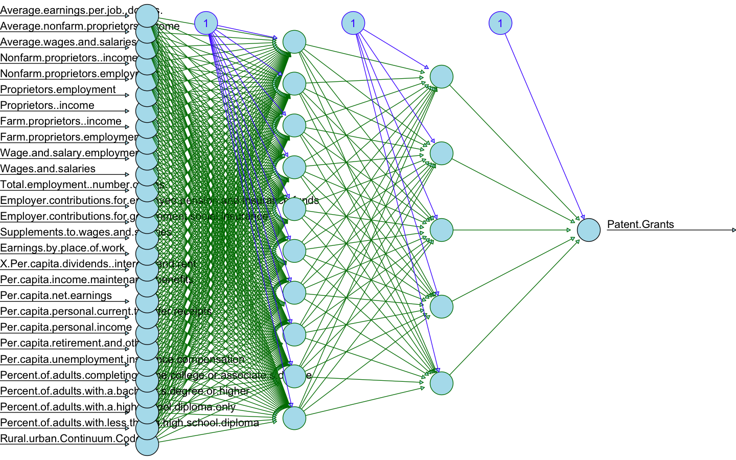

Slide 13
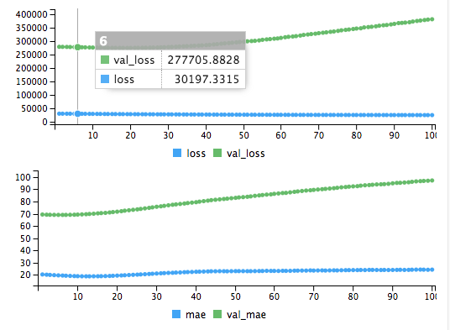
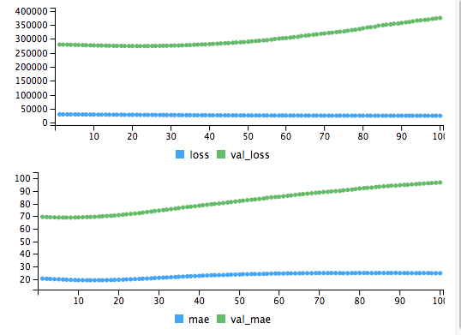
Training the Neural Network with 4K training Instances
The Neural Network with 0 hidden layer and only I/O layer and 5 nodes in the input layer
The Neural Network with 0 hidden layer and only I/O layer with 10 nodes in the input layer

Slide 14
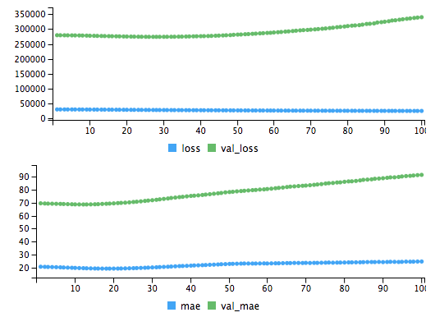
The Neural Network with 2 hidden layers and 10,5 nodes respectively in each hidden layer

Slide 15
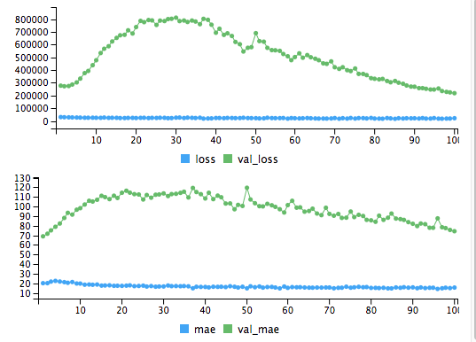
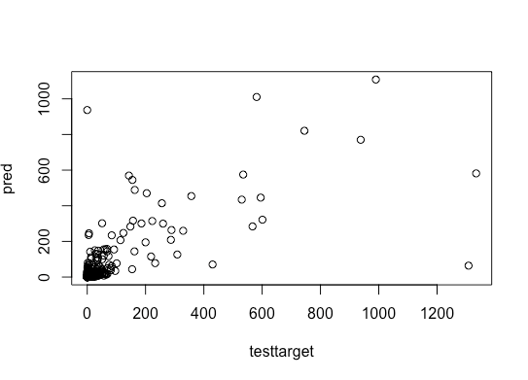
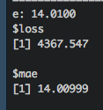
The Neural Network with 3 hidden layers and \50, 20,5 nodes respectively in each hidden layer.
Prediction graph of the number of patents

Slide 16
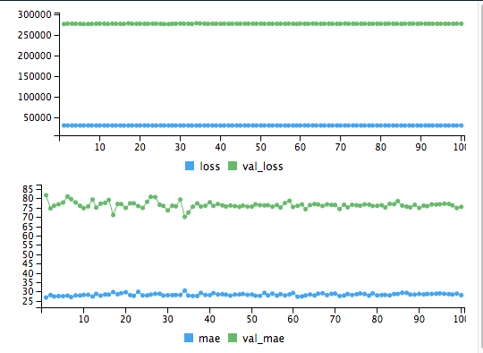
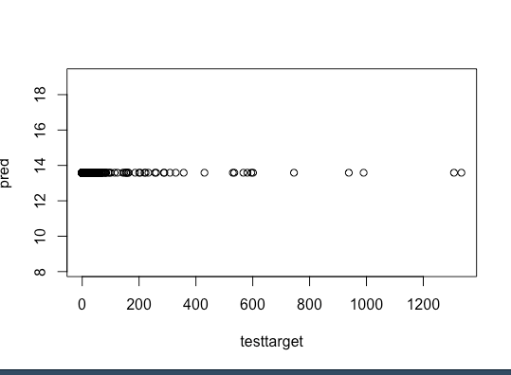
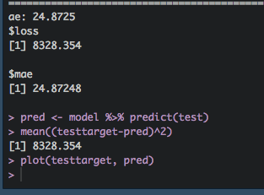
The Neural Network with 4 hidden layer and 200,100,50,30 nodes respectively in each hidden layer

Slide 17
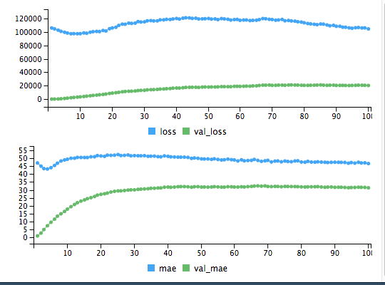
Training with 31 Thousand Instances
The Neural Network with 0 hidden layer and only I/O layer.
- Least Complex Neural Network Model

Slide 18
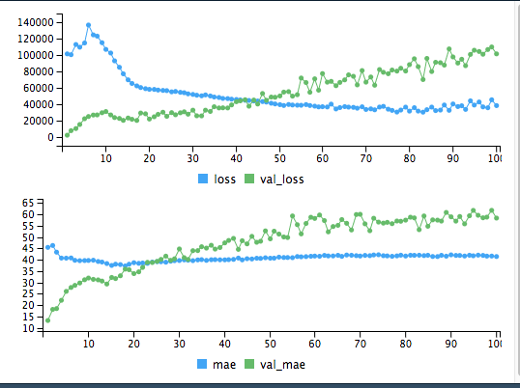
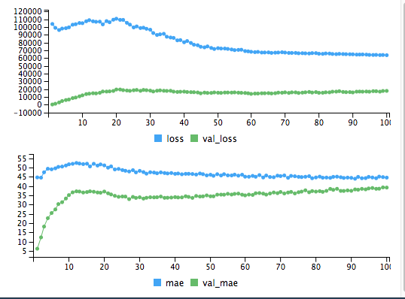
The Neural Network with 1 hidden layer and 100 nodes in the first hidden layer.
The Neural Network with 2 hidden layer and 100 and 50 nodes in the hidden layers respectively

Slide 19
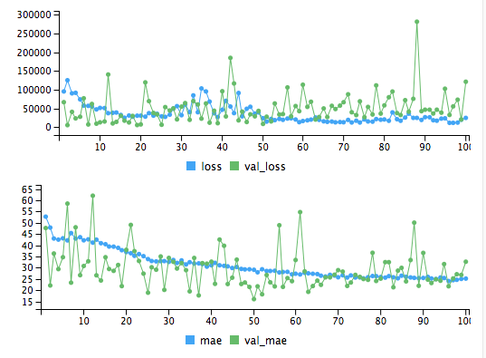
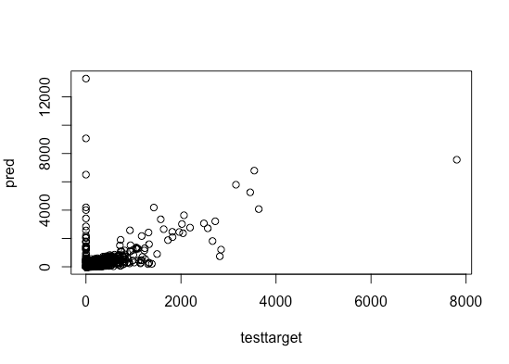
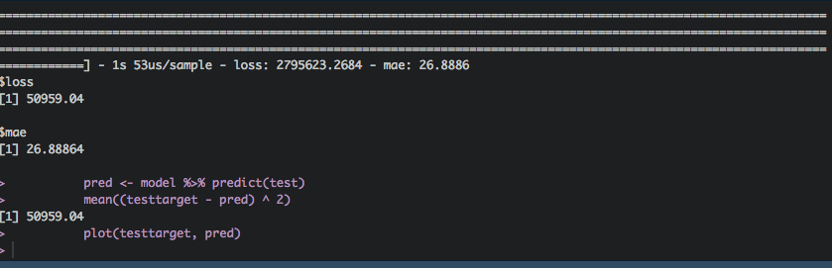
The Neural Network with 5 hidden layers and 150,100,50,30,20 nodes in the hidden layers respectively – Most Complex Neural Network model

Slide 20
Neural Network Results
We implemented the Neural Network Model in two stages
In First case we finetuned ANN’s hyperparameters multiple times with 4k training instances.
In second case we finetuned ANN’s hyperparameters multiple times with 31k training instances.
The Mean Absolute Error which we got in the first case with highest complex ANN model was 24.87428. However the model was Overfitting
The Mean Absolute Error which we got in the second case with highest complex ANN model was 26.88864. However the model is not Overfitting

Slide 21
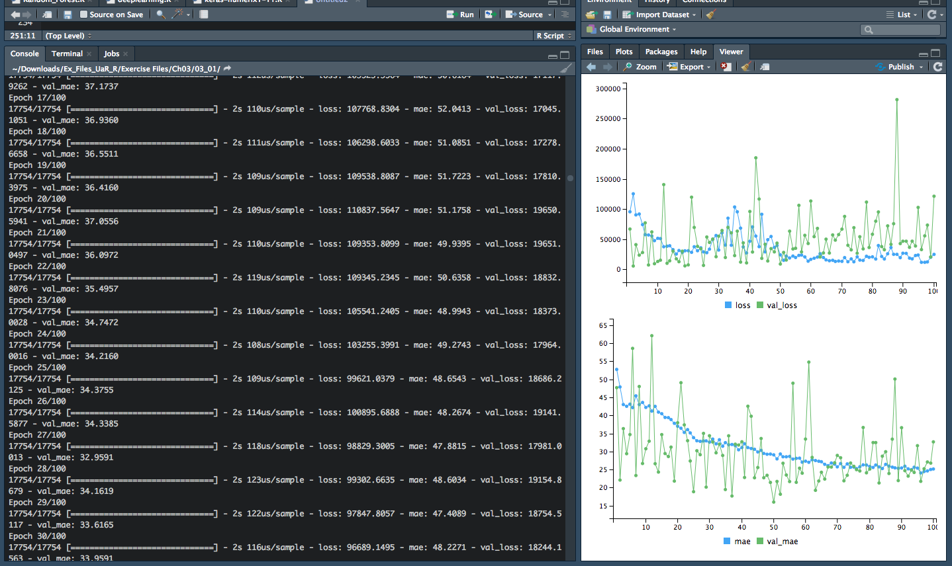

Slide 22
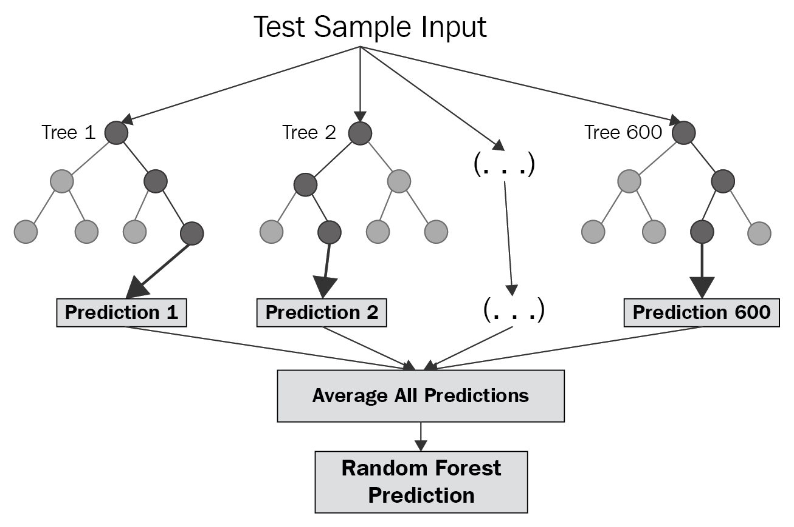
Random Forest algorithm Implementation
How Random Tree Algorithm functions:
[ tree plot and explanation ]

Slide 23
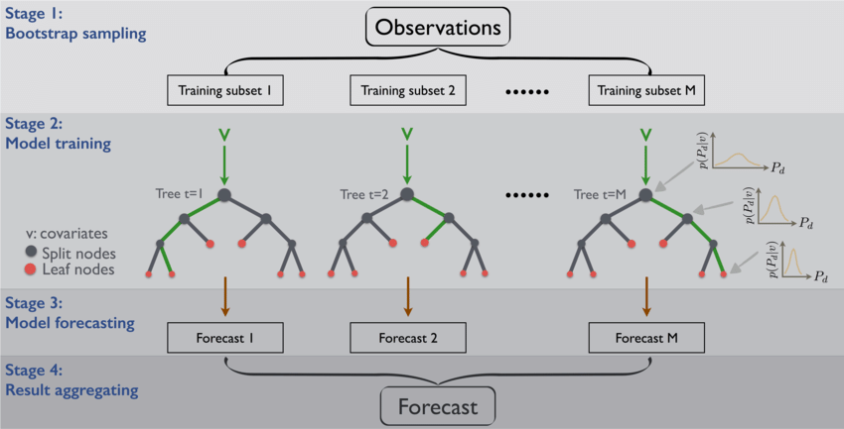
MAIN PRINCIPLE

Slide 24
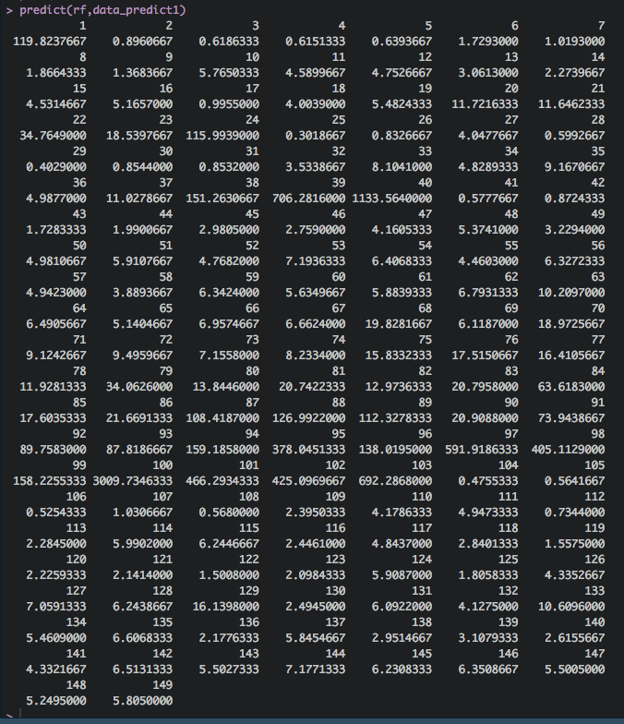
Results

Slide 25
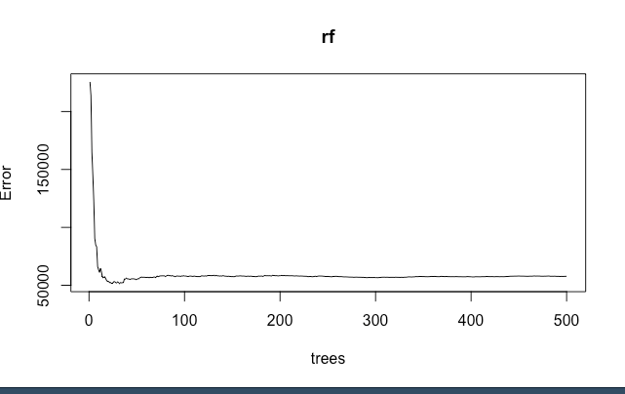
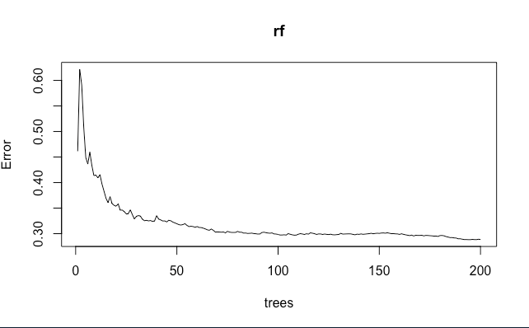
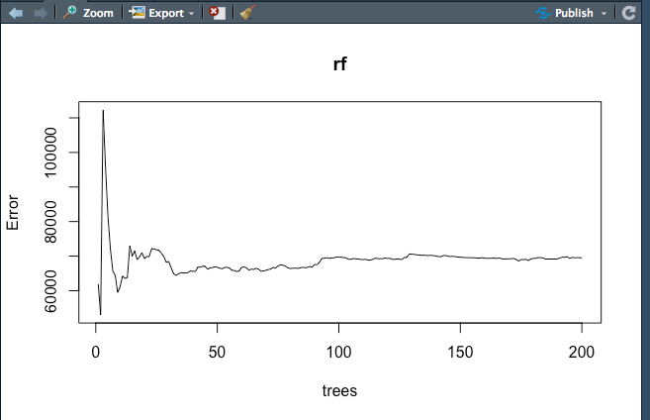
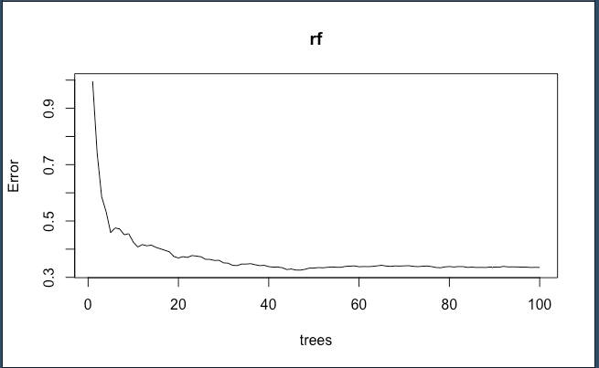
Results

Slide 26
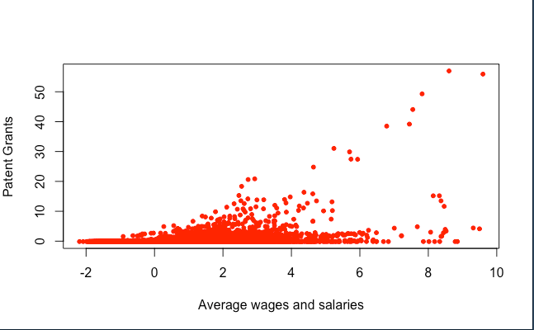
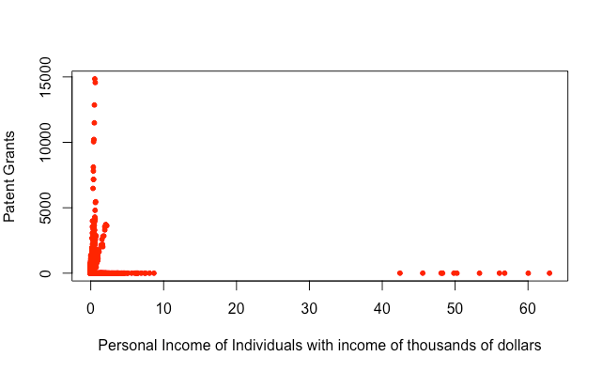
Data Analysis

Slide 27
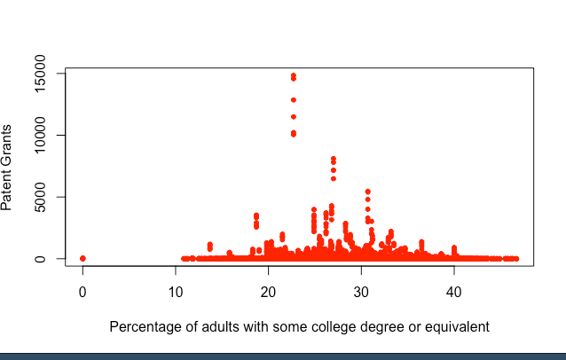
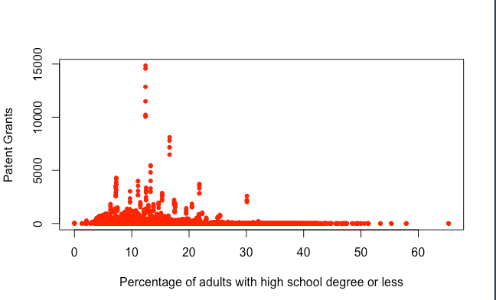

Slide 28
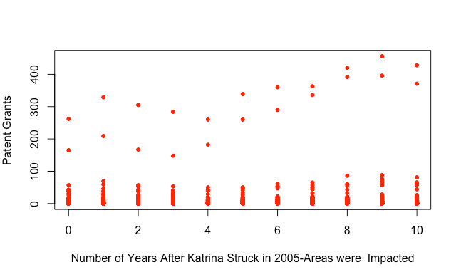

Slide 29
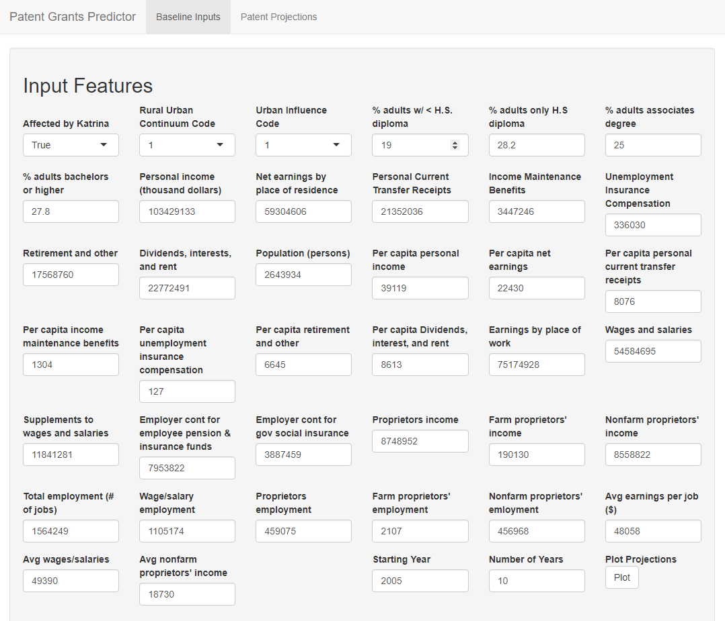
Model Interface
Can extend this capability into an interface to run ad- hoc modeling for the metrics of a given locality.

Slide 30
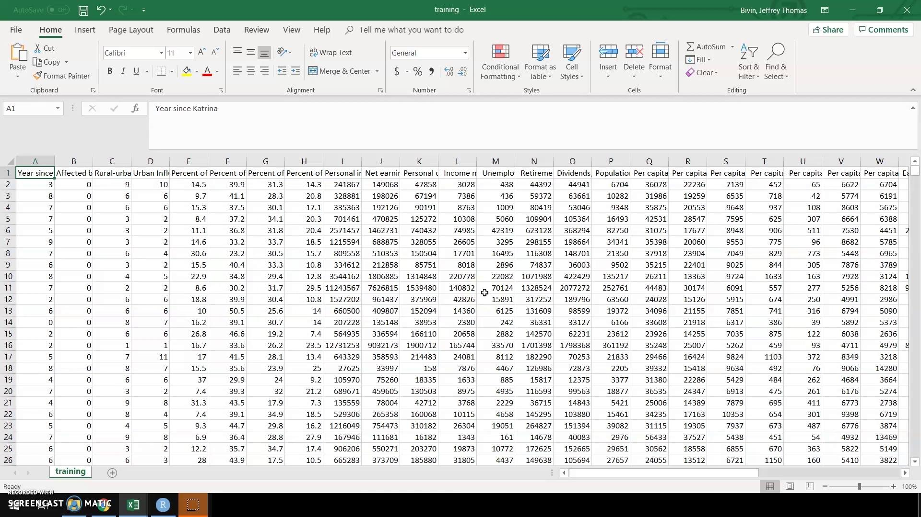
Interface Demo

Slide 31
References of Research Papers Used
The Impact of Uncertainty Shocks on Innovation
Ballesteros, Luis
(Under Review )
Human Decisions and Machine Predictions
Kleinberg- Jon- Jure- Ludwig- Jens- Mullainathan- Sendhil - https://www.nber.org/papers/w23180
Migration, Financial Constraints, and Entrepreneurship: Evidence from Mexico
Wang, Qing. (2013).
https://www.researchgate.net/publication/272301695_Migration_Financial_Constraints_and_Entrepreneurship_Evidence_from_Mexico
Prediction Policy Problems
Jon Kleinberg, Jens Ludwig, Sendhil Mullainathan, and Ziad Obermeyer
https://www.cs.cornell.edu/home/kleinber/aer15-prediction.pdf
Machine learning methods for demand estimation
Patrick Bajari, Denis Nekipelov, Stephen P. Ryan, and Miaoyu Yang∗
https://www.aeaweb.org/articles?id=10.1257/aer.p20151021

Slide 32
Thanks!
See the code on GitHub at https://github.com/ayushaan94/CSCI-6221-Advanced-Software-paradigm-
CSCI 6221 – Group 2
Ayush Dwivedi | Jeff Bivin | Tyler Jones

